Slide 1
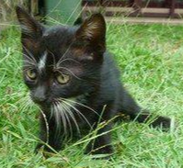
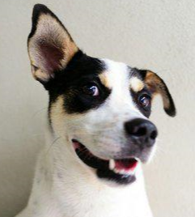
Springboard Pet Adoption Milestone Report for Capstone I July 2019 by John L. Parsons

Slide 2
Pet Adoption Business Objectives
The goal for this project is to reduce shelter cost by significantly reducing the number of animals that stay in the shelter for more than 100 days. This will be achieved by;
Develop a champion machine learning model to predict which animals are the least likely to be adopted from the shelters and minimize the animal’s length of time in the shelter which reduces shelter costs.
Build a Cox Survival Analysis Recommendation Model that can rank animals which are the least likely to be adopted from the shelters for more than 100 days. These animals will be targeted first for adoption to potential adoptees.
Perform a text analysis of pet Names to determine which names are the best or worst predictors for AdoptionSpeed. Create a Standard Operating Procedure for creating a “Framing Affect” for those names that increase a pet's chance for being adopted out of the shelter.

Slide 3
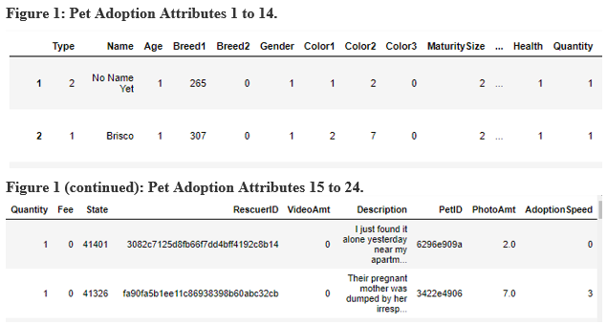
Pet Adoption Variables

Slide 4
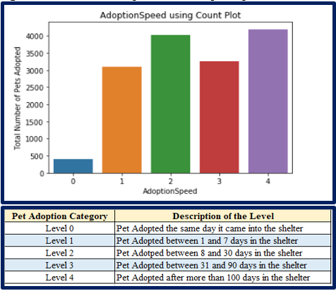
Description of Target Variable AdoptionSpeed

Slide 5
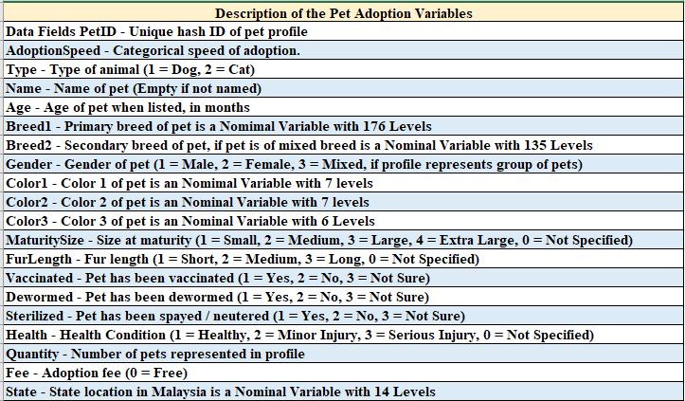
Description of all 24 Pet Adoption Variables

Slide 6
Client
PetFinder was founded by Betsy and Jared Saul in 1996 in Pittstown, NJ. This became the largest online Pet Adoption company that has listed over 350,000 adoptees from 14,000 shelters across the world.
PetFinder was purchased by the Nestle Purina Pet Care Company in June of 2013 and was the first major acquisition of a digital company.
The business goals are targeted to decrease shelter time for pets, which will benefit the board of directors, investors, 18,000 employees and 400 scientists who work for the Nestle Petcare company to continue achieving their goals and make this a successful campaign for people and pets.

Slide 7
Missing Data
The training data set did not have any missing values for the numeric variables.
Two non-numeric variables contained missing values and these were the Name and the Description attributes for the pet.
The Name variable had a total of 1,257 missing values and the Description only had 12 missing values. The missing rows will be removed for the text analysis section of this study.

Slide 8
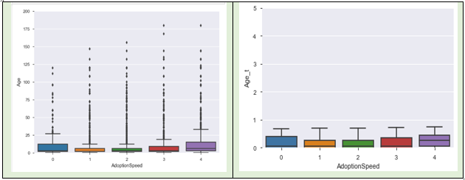
OUTLIERS
Age vs. Age_t comparison in a Box Plot
Age and Breed1 variables has several outliers for these input attributes.
The Age variable ranged from 0 to over 250 for this data set.
The Age attribute will be Log10 transformed to minimize the number of outliers.

Slide 9
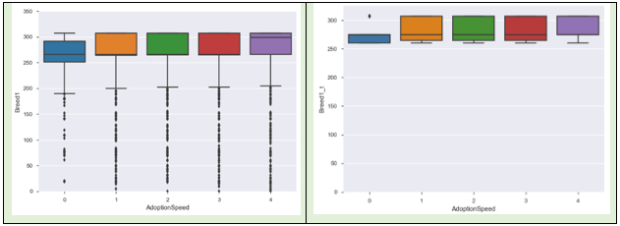
OUTLIERS
Breed1 vs. Breed1_t comparison in a Box Plot
Breed1 variables had a total of 176 unique factors for this variable .
Breeds 266 and 307 remained as one category and then the remaining values were placed into two groups
Breeds that were less than or equal to 265 were placed in the bin named 265 and all breeds greater than and equal to 267 (except for 307) were placed in another bin called 275.

Slide 10
Multifactorial Input Variables
The State variable had a total of 14 nominal levels and 41326 accounted for a total of 8,714 of the pets and 41401 accounted for 3,845 of the pets.
Number 41326 is from Selangor and 41401 is from Kuala Lumpur in Malaysia and remained as 2 levels.
The remaining 12 levels were merged into one group called 41000.
The Quantity ordinal variable had a total of 19 levels and range from 1 to 19 for this dataset.
The greatest number of adoptions occurred when only one pet was listed at a time and this accounted for 11,565 of these pets. A total of 1,422 rows accounted for two pets listed at a time.
The Quantity variable will bin all animals that had 2 or more animals for a listing into group 2 .

Slide 11
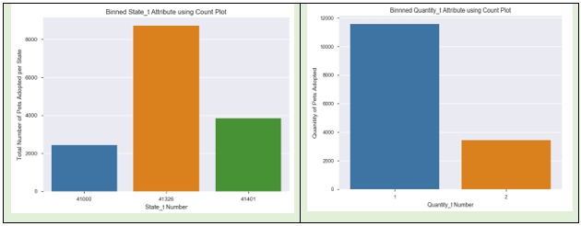
Binned results for State_t and Quantity_t Variables

Slide 12
Ordinary Least Squares and Tukey Results
Four variables that were tested to determine if there were no significant differences between these input attributes and the target variable. These four variables are Gender, Type, Sterilized and Vaccinated.
The results show a significant difference in the means between the male and female pets and the male and mixed lot pets.
The Type and Sterilized variables were also significant for all levels and the null hypothesis could be rejected and accept the alternative Hypothesis.
The Vaccinated attribute results show the null hypothesis could be rejected for pets that were vaccinated to those that were not vaccinated. The animals that were not vaccinated to those which did not have records was also significant and the null hypothesis could be rejected and accept the alternative hypothesis.

Slide 13
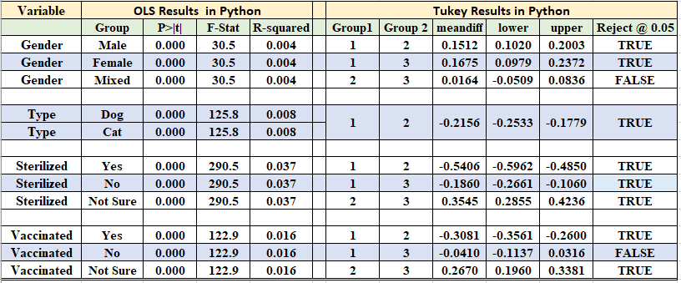
Statistical Results from the OLS and Tukey Models in Python

Slide 14
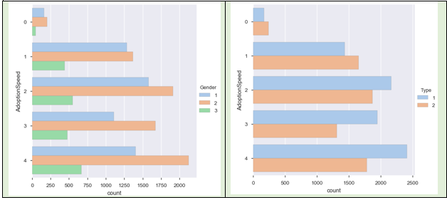
Bar Count Plots for Gender and Type Variables

Slide 15
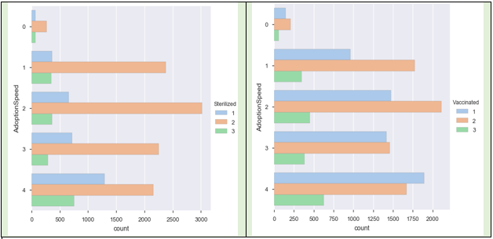
Bar Count Plots for Sterilized and Vaccinated Variables

Slide 16
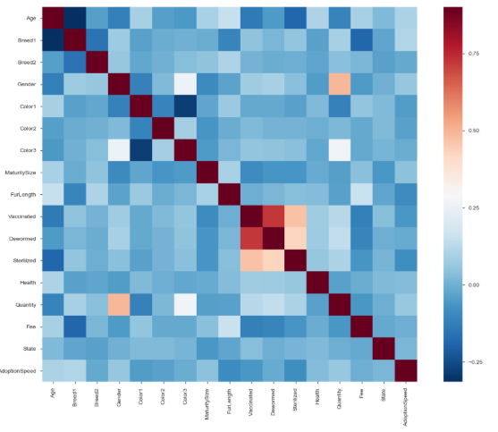
Heatmap for all Numerical Attributes of Pet Adoption
Breed1 and Age attribute has a slight negative correlation with a value -0.314.
Color1 and Color3 also had a slight negative correlation with value of -0.282.
Vaccinated and Sterilized was 0.47 and the Dewormed and Sterilized was 0.436 for the Pearson Correlation Matrix.
Vaccinated and Dewormed had the highest correlation and was 0.72. These values have a high multicollinearity and will not be used together in the final model.

Slide 17
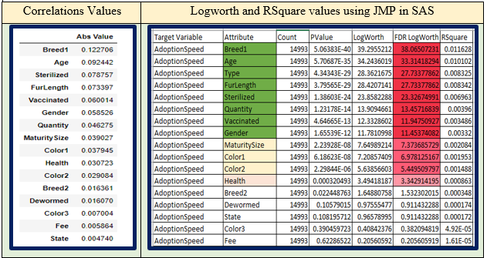
Variable Importance and Variable Selection
All 17 input variables will be used to create the baseline model for this study.
A total of eight attributes have been selected for the optimized model. These are; Age, Breed1, FurLength, Quantity, Vaccinated, Gender, MaturitySize and Sterilized.

Slide 18
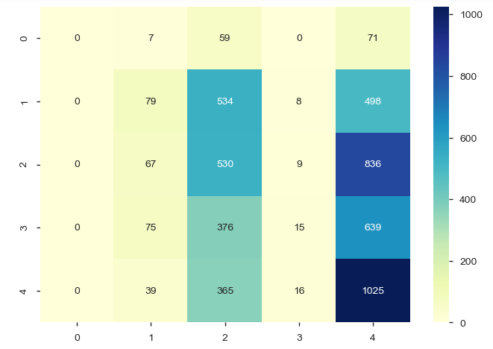
Logistic baseline Model results
The baseline model will use all 17 original numerical input variables to get a baseline result for the five-ordinal level of AdoptionSpeed.
The standard Logistic Regression model will use C = 1 and a penalty of L1 for the model. The data was divided into a 65:35 split between the training and testing data.
The baseline model with all 17 attributes had low accuracy scores for the Logistic Regression. The Accuracy results from this model was at 33 percent and the Confusion Matrix shows the distribution of the results.
Confusion Matrix for Baseline Model

Slide 19
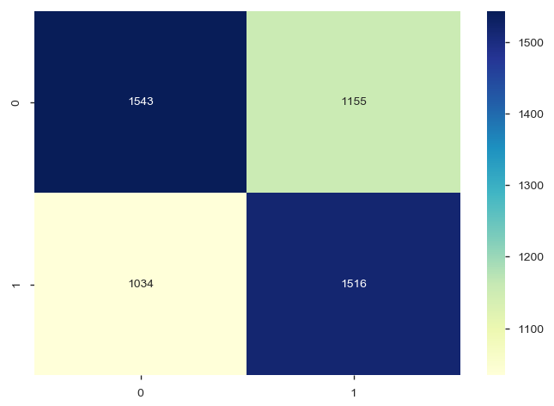
Optimized Logistic Model results
Confusion Matrix for Optimized Model
The optimized model will have eight select input variables and these are; Breed1_t, Age, Type, FurLength, Sterilized, Quantity_t, Vaccinated and Gender.
The Target Variable AdoptionSpeed was binned into two levels and is called AdoptionSpeed_t variable.
AdoptionSpeed levels 0 to 2 are in the 0 group and levels 3 and 4 are in the 1 group.
The accuracy score was much higher than the baseline model with a value of 58%.

Slide 20
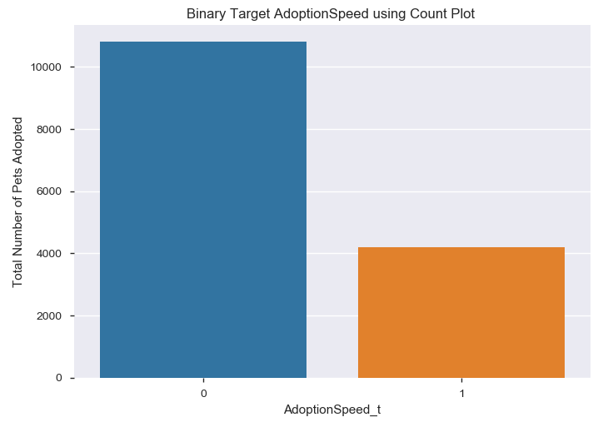
Preliminary Survivorship Model results
The Cox model and Kaplan Meier Fitter Models will be used for Survivorship Analysis with the top eight input variables.
The Target Variable will bin levels 0 to 3 into the 0 group and level 4 will be binned into the 1 group.
the Cox coefficients and hazards functions shows seven of the eight attributes had a significant impact on AdoptionSpeed_t2 and Vaccinated was the only variable that did not have a significant affect with a p value of 0.64.
The goodness of fit value for the current model was at 72 %.
Binned AdoptionSpeed Attribute

Slide 21
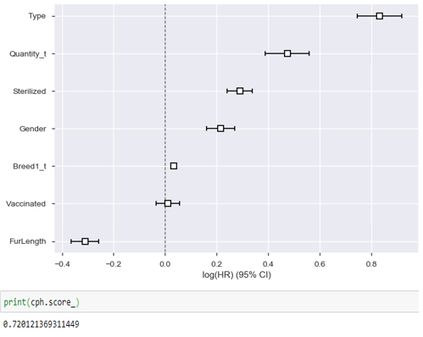
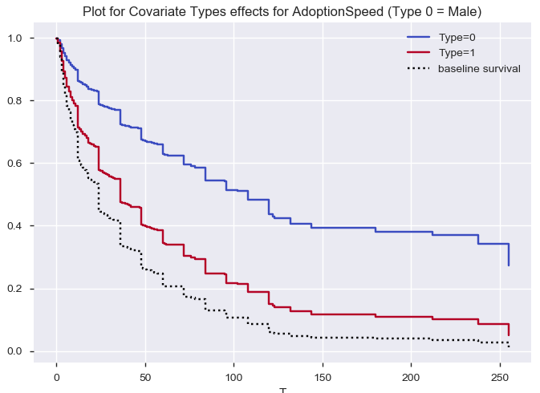
Cox coefficients plot and lifespan graph for the type variable
Cox Model Coefficients Plot
Lifespan Plot for the Variable Type

Slide 22
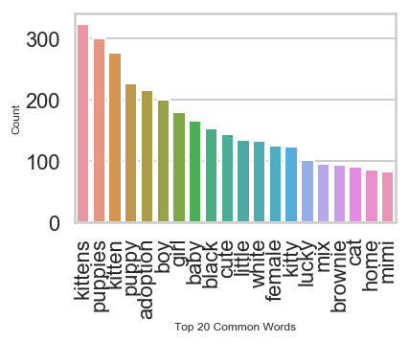
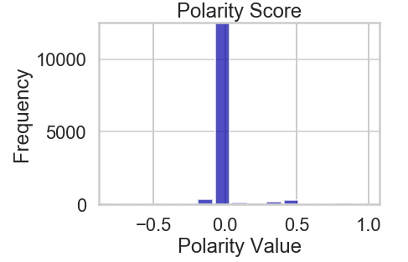
Text analysis for the name attribute
The Text Analysis for the Pet Adoption Dataset will only look at the Names of the pets to calculate the term frequency, word count, polarity value and then use the Naïve Bayes and Random Forest to determine if Names can predict the AdoptionSpeed of the animal.
Top 20 Common Names
Polarity Scores for Name
Names selected for the pets seemed to be more descriptive in nature and tell the potential adoptees the type of pet and physical description.
The majority of names have a polarity score of 0 or is neutral.

Slide 23
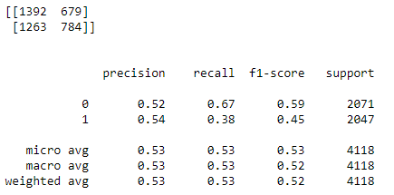
Preliminary Naïve Bayes Model results
A preliminary test was set up for the text analysis using the Name and AdoptionSpeed in the Naïve Bayes model.
The standard preprocessing steps were performed (remove punctuation, stopwords and convert all letters to lower case) and the words were vectorized with the bow transformer approach in Python.
The Naïve Bayes model tested the Name attribute with the five ordinal and the binomial level target variables.
The accuracy results for the five-level target variable was 21% compared to 53% for the binomial level.
Naïve Bayes Model Results for binomial Target Variable

Slide 24
conclusions
The Pet Adoption Milestone Report for Springboard has listed the problem statement for pet adoption and three problems to address for the business objective. The three business goals are:
Reduce the cost to maintain shelter pets by creating a champion model that can predict which animals are the least likely to be adopted,
Create a survivorship model to predict which animals that are least likely to leave the shelter and target these animals to potential adoptees,
Text analysis for the Name of the pets and determine which names have a higher adoption rate. This can be used as a “Framing Effect” to be more successful in the adoption campaign.
The next set of deliverables will be the completion of the Capstone I project which will contain the champion model to predict AdoptionSpeed, the best survivorship model to predict which animals are least likely to stay in the shelters and the most efficient names to be used for pet adoption.

Slide 25
REFERENCES
Animal Farm Foundation. (ND). Naming Shelter Dogs: The Framing Effect. Retrieved from:
https://animalfarmfoundation.blog/2013/04/08/dog-names-framing/
Davidson-Pilon, C. (ND). Lifelines. Retrieved from: https://lifelines.readthedocs.io/en/latest/
Foothills Animal Shelter. (ND). Services; Lost and Found Fees. Retrieved from:
https://foothillsanimalshelter.org/services/lost-and-found/fees/
Hastie et al. (2017). The Elements of Statistical Learning: Data Mining, Inference and
Prediction. Springer Series in Statistics, 2nd Edition.
Purina. (2013). Nestle Purina completes acquisition of Petfinder. Retrieved from:
http://newscenter.purina.com/2013-07-15-Nestle-Purina-completes-acquisition-of-Petfinder

